Slide 1
IS 436 Deliverable 4
By: Jessica Park, Farah Siddiqui. Betelhem Taddele, Danny Nguyen, Jatin Chauhan, Munam Ghazanfar, Ninh Ngo, Adil Mufti

Slide 2
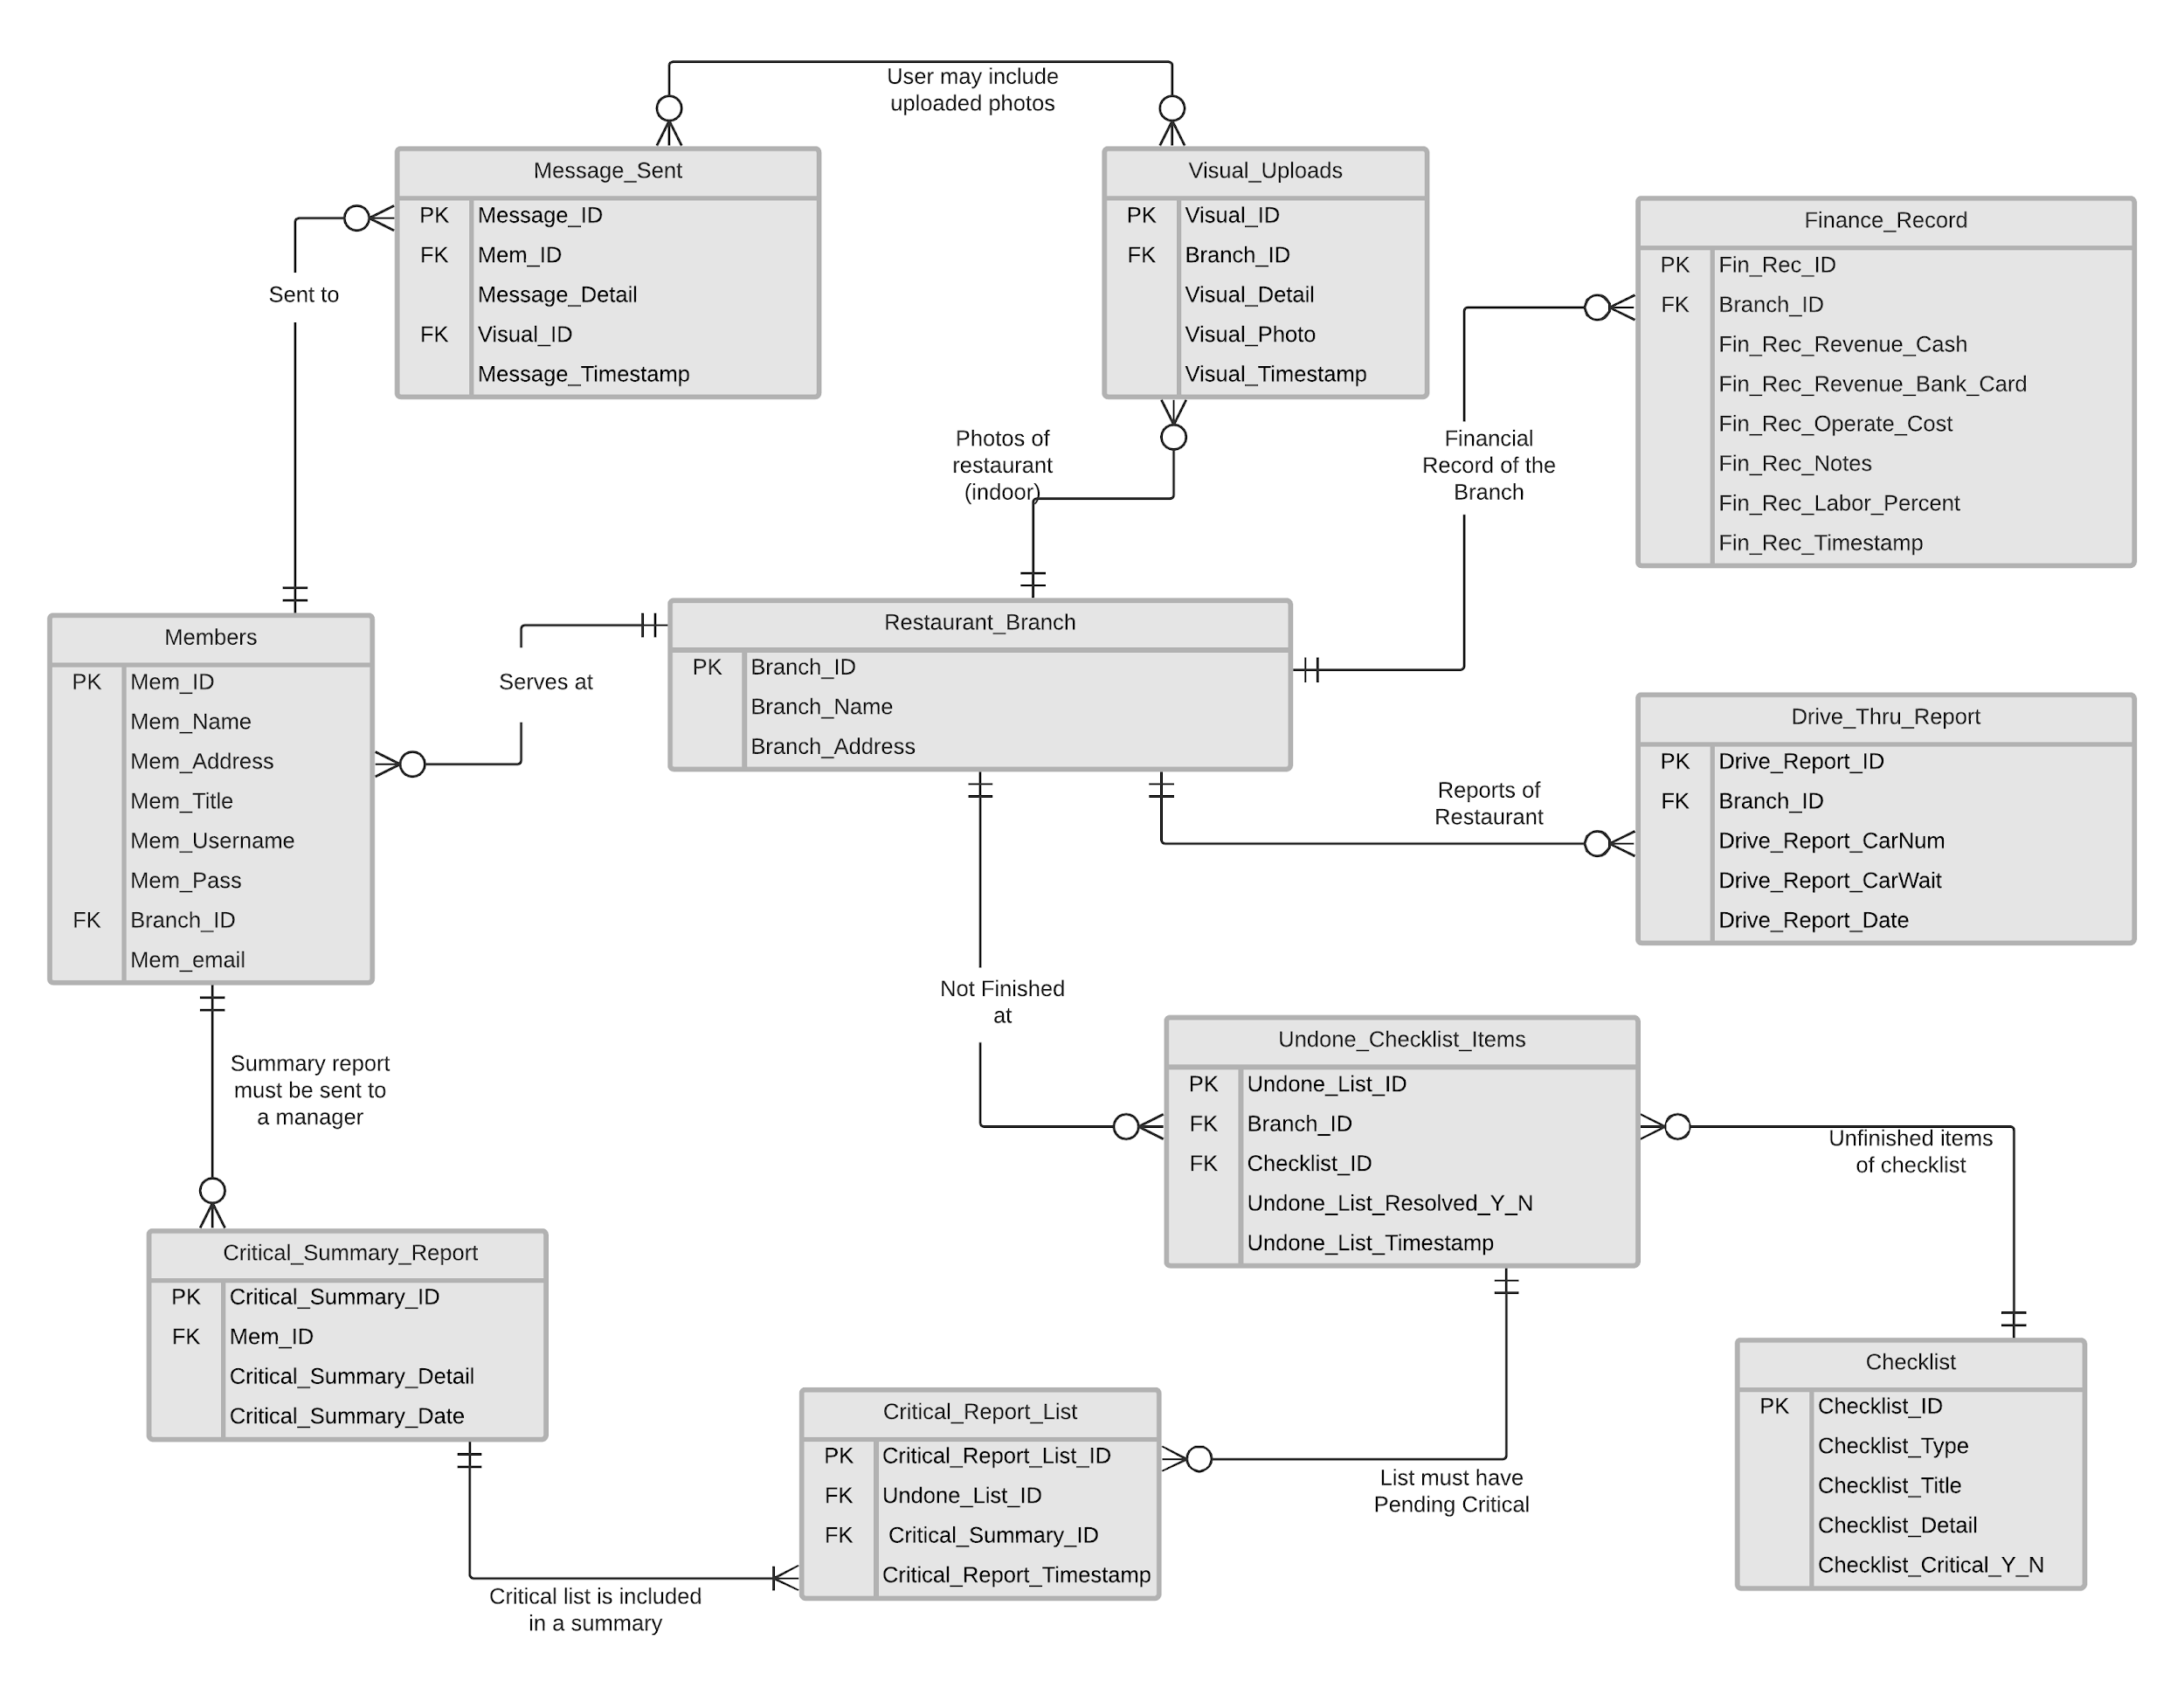
ER Diagram

Slide 3
Alternative Matrices
Custom In-House Server :
Cost = $1,300 for Server Tower, $300 for MS Server Essentials OS
Maintenance = High
Scalability = High
AWS Custom Build
Cost = EC2 a1.Large (2 CPU, 4 GB Ram, EBS Storage, SQL Supported) $263 a year upfront
Maintenance = Mid
Scalability = High
Web Hosting GoDaddy
Cost = Web Builder Plan $9.99 Month
Maintenance = Low
Scalability = Low

Slide 4
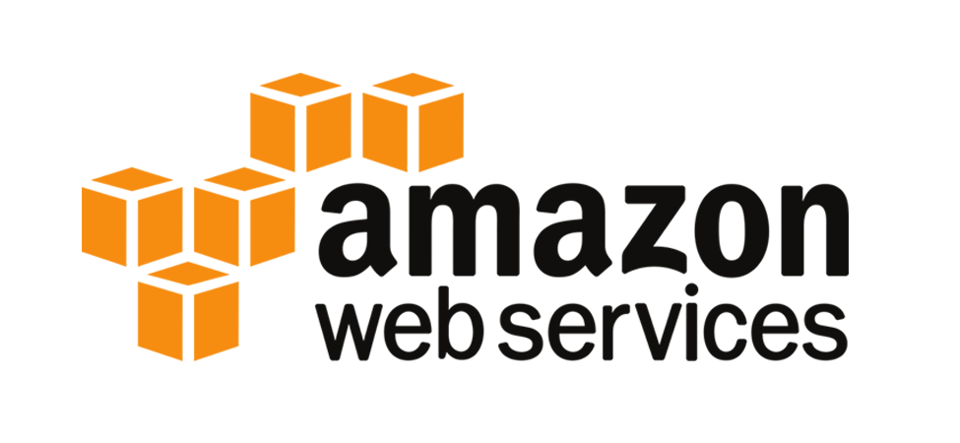
Team Alternative Matrix
As a team AWS custom build was our solution of choice
AWS comes with a medium cost but high functionality and a plethora of scalable services
Small-Med learning curve for stakeholder at hand-off
Appropriate for project as it supports SQL, storage/storage redundancy
Negative – Due to time limitations and in-experience with AWS, the demo product will be hosted on GL server.

Slide 5
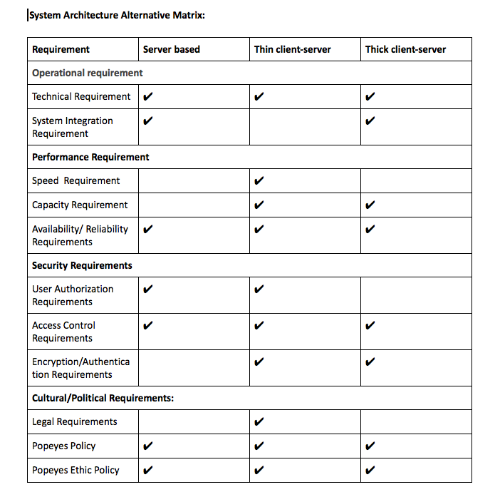
Systems Architecture Matrix
A thin-client server is the most cost-saving option for the other system architectures.
Simplified management system.
It is easy to manage the system and utilize it with many different software options which can help to simplify the use of the system.
It is centralized and simplifies the use of the system and simplifies backup of client access devices.
In addition,a thin-client server has an enhanced security that is critical for our system. The system will store user’s information, and it is a top priority to keep this protected and secured
problem that comes with a thin-client server is its centralized nature, which can result in loss of data if the server fails.

Slide 6
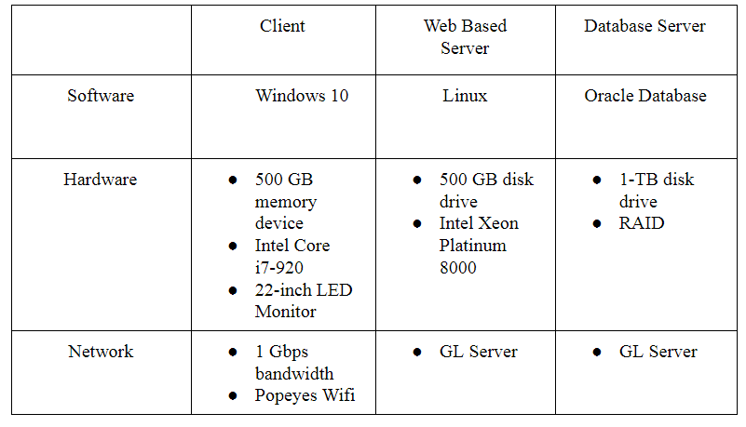
Hardware and Software Specification

Slide 7
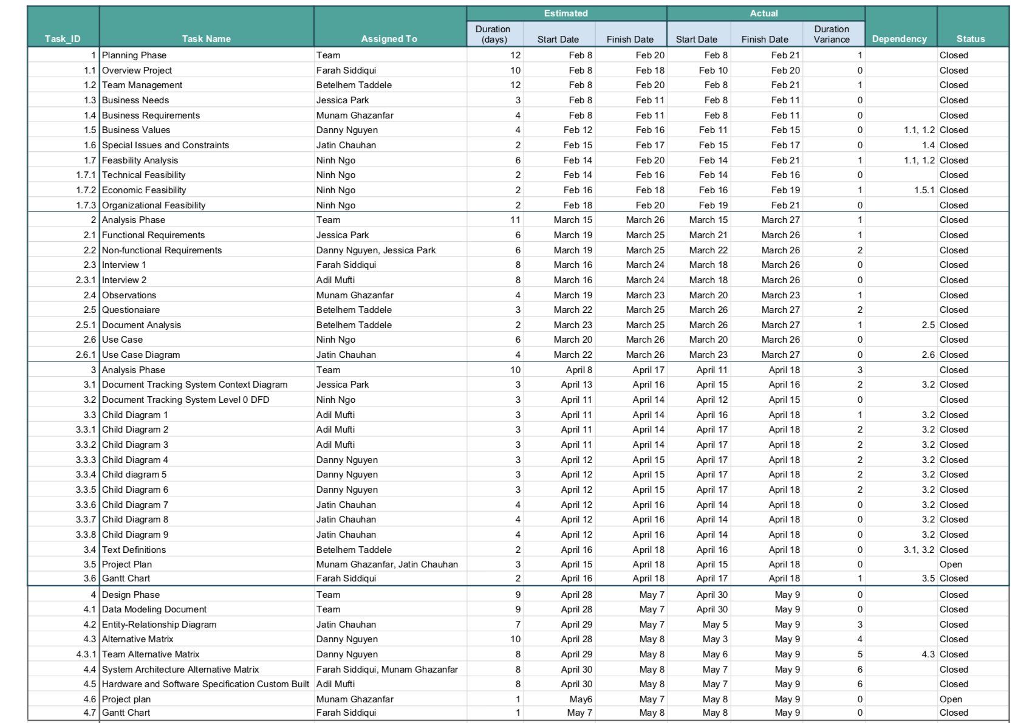
Updated Project Plan

Slide 8
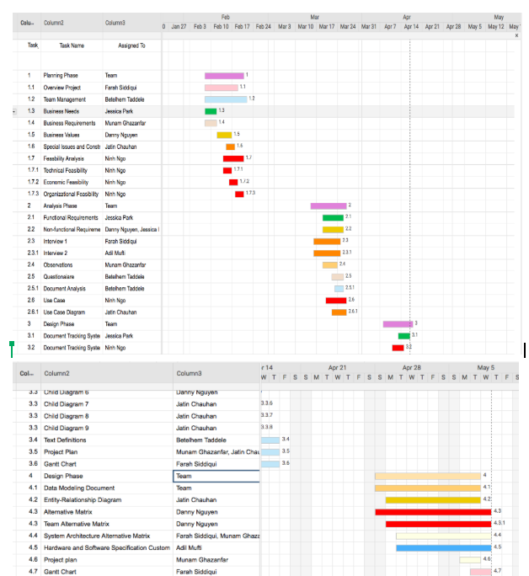
Grantt Chart

